Slide 1
Online Issues and parental controls

Slide 2

Notes:
Interaction with ANYONE. Catfishing, scams, etc.

Slide 3
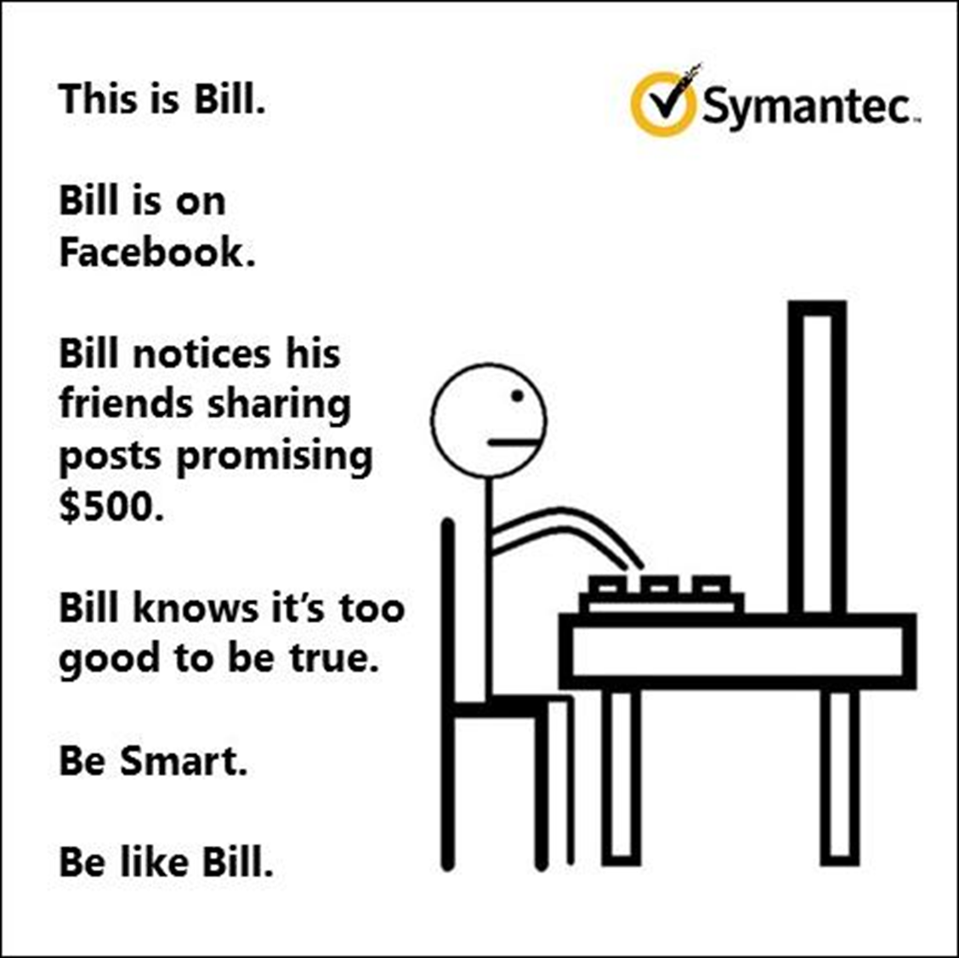
Notes:
Scams, in app purchases, data overage $$$$$$

Slide 4
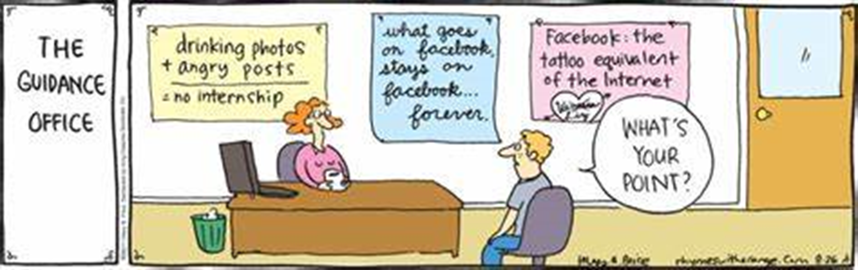
Notes:
Loss of reputation. Making posts they regret

Slide 5

Notes:
Peer conflict. We can be very nasty online. Please do not engage with the child. Take a screen shot and speak to a parent or teacher.

Slide 6

Notes:
Kids can see content that could be harmful.

Slide 7

Notes:
Once you send something. You can’t get it back. Sexting/nudes

Slide 8
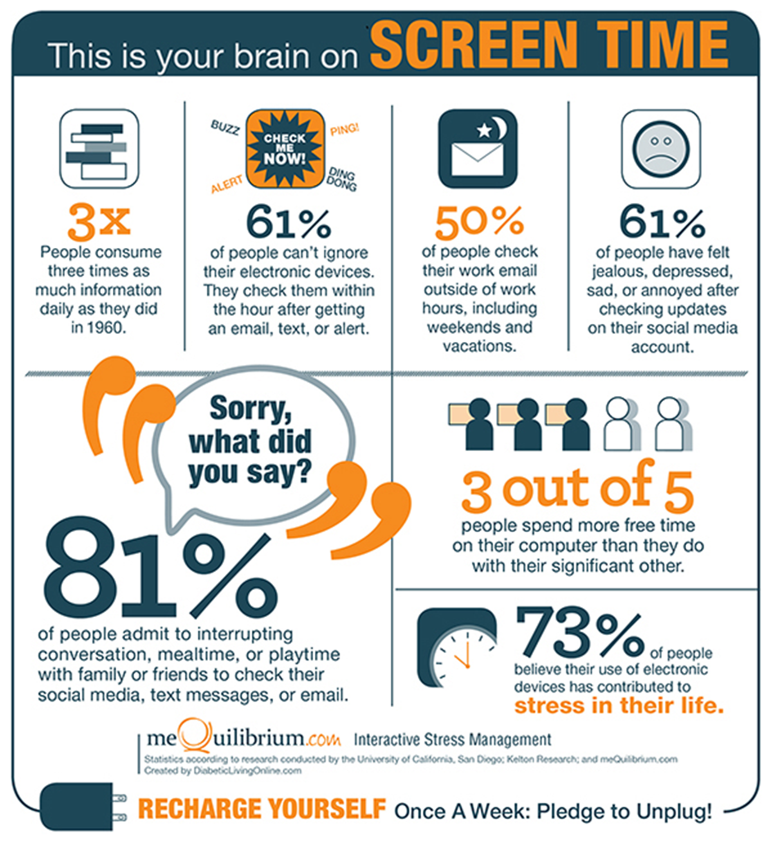
Notes:
High screen time is harmful to our lives.

Slide 9
Notes:
Child exploitation is growing.

Slide 10
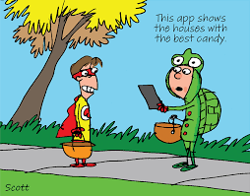
-

Slide 11

Purpose
You choose what your child can access
They can still use important safety features
There’s no need for constant monitoring
It can be altered with age

Slide 12
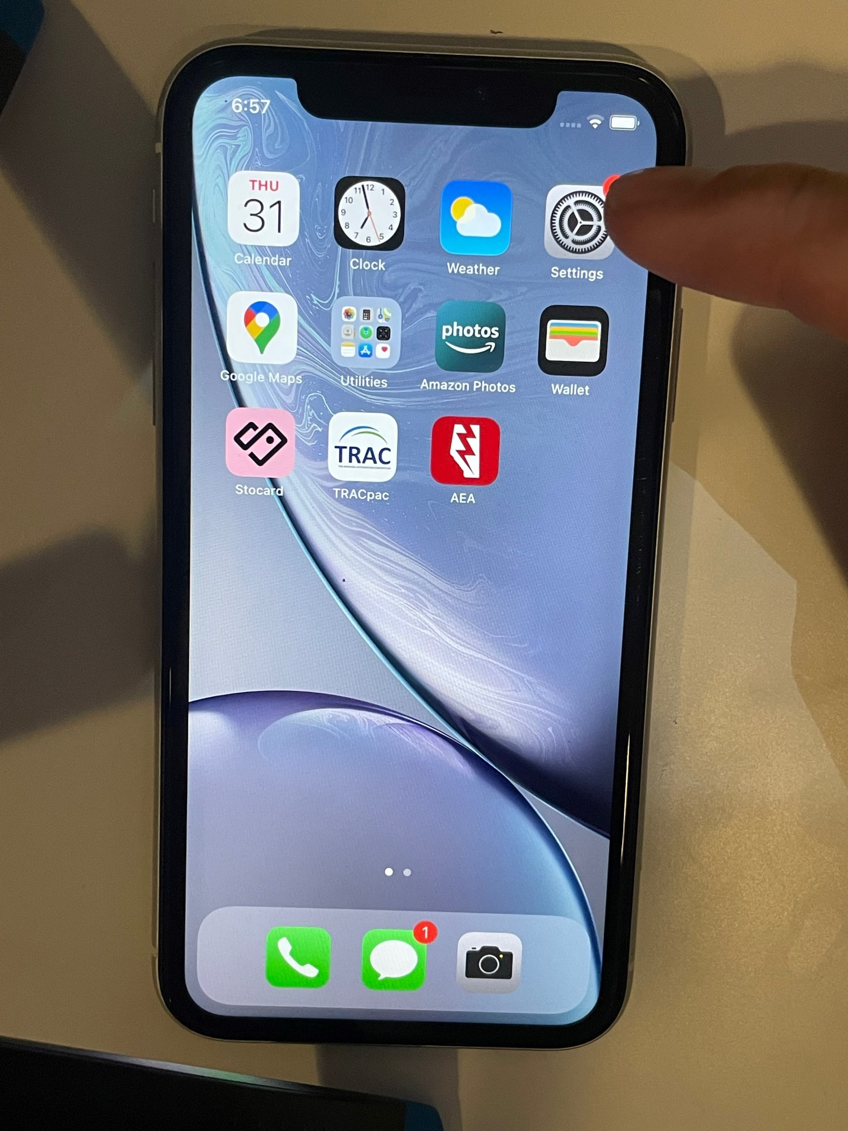
-This is a 3-year-old iPhone X.
-The old sim card is removed.
-Go to settings.

Slide 13
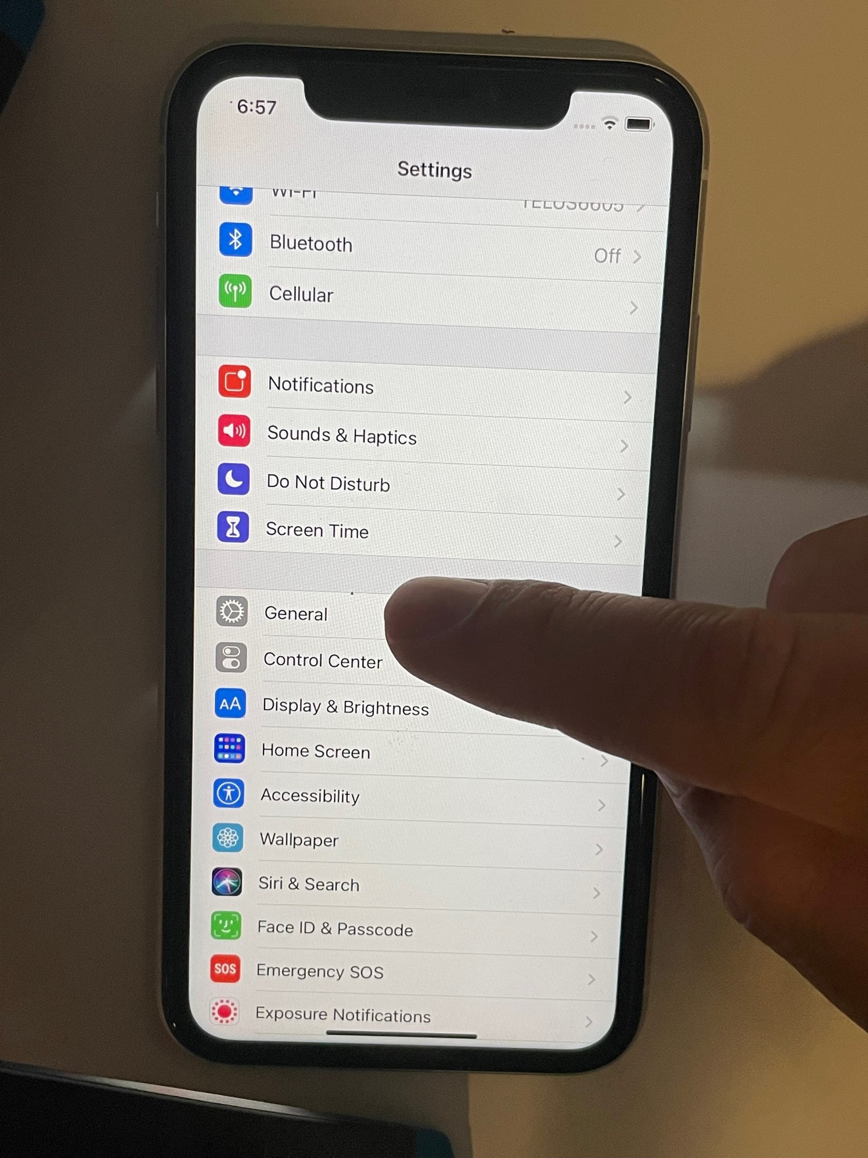
-Select the General Tab.

Slide 14
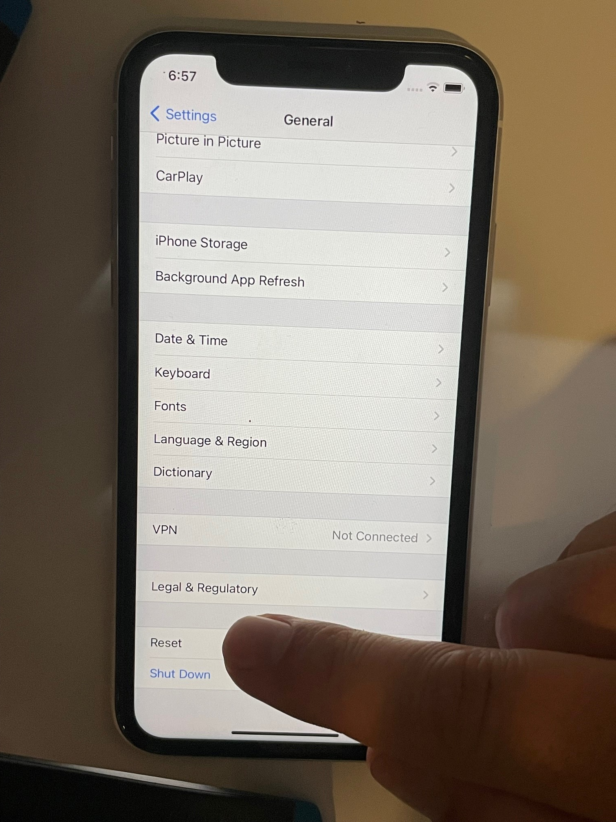
-Scroll to the bottom and select Reset.

Slide 15
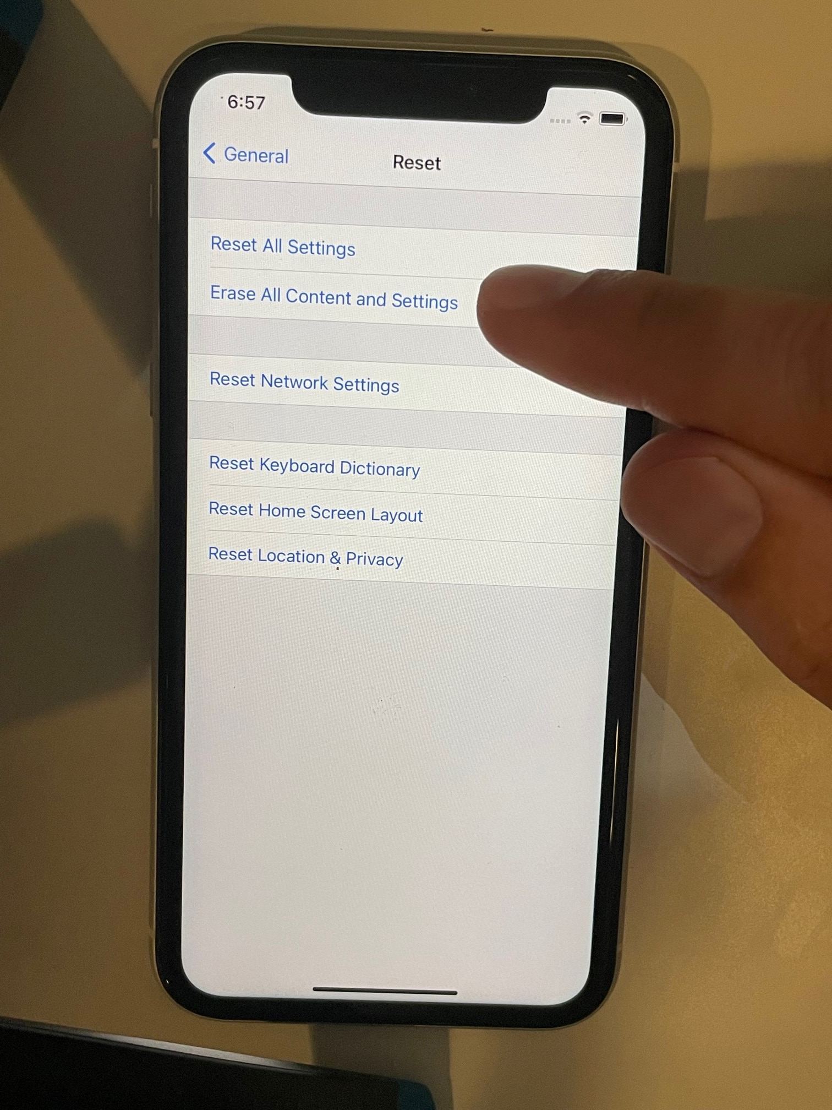
-Select Erase All Content and Settings.

Slide 16
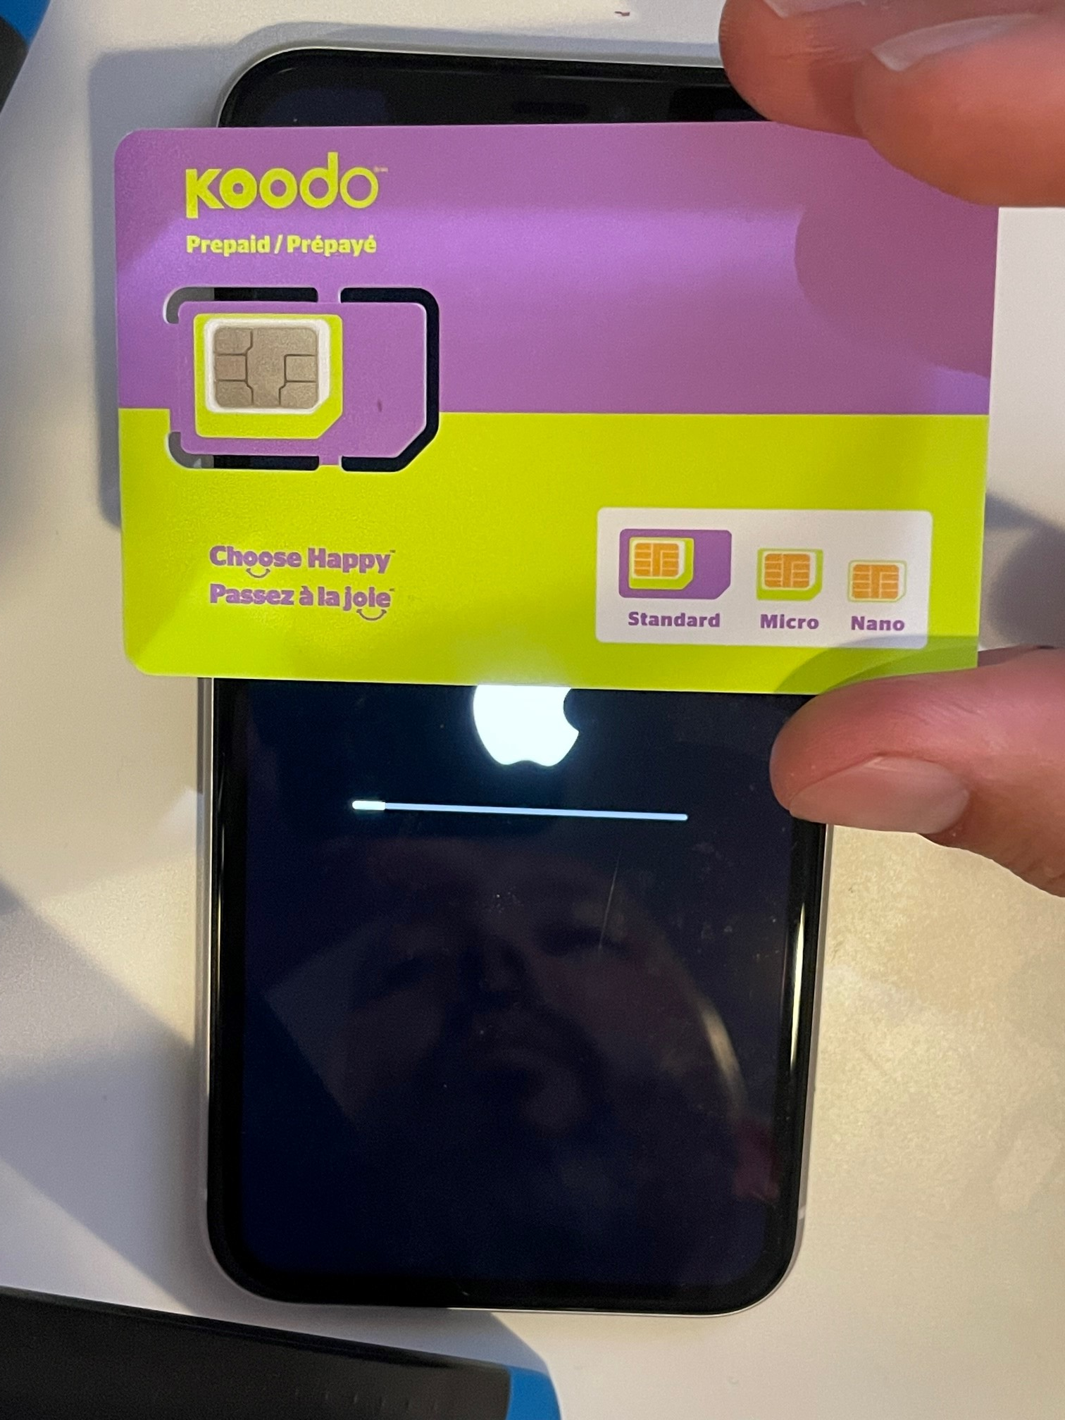
-You will need a new SIM card.
-I ordered mine for $5 from Telus.

Slide 17
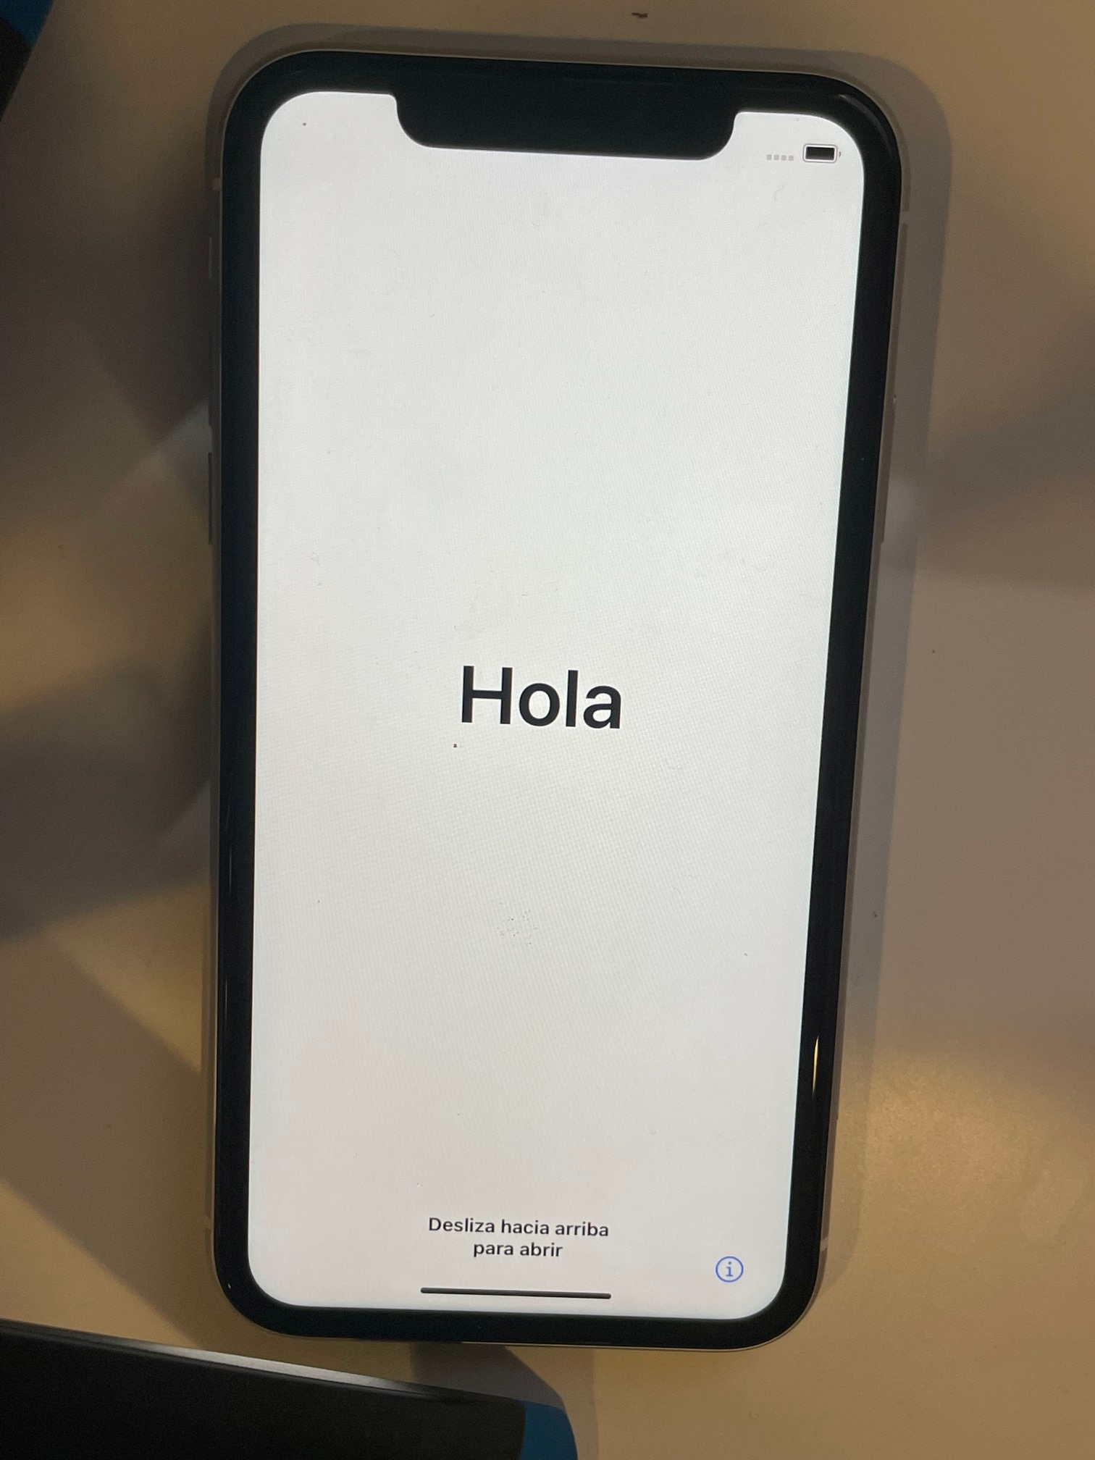
-Success!
-This is a factory reset iPhone.
***you can do a factory reset with your child’s existing phone

Slide 18
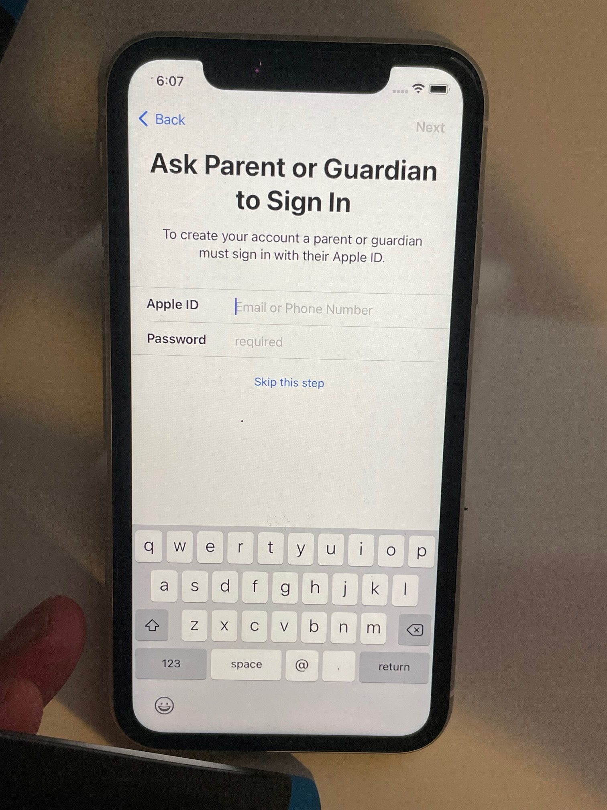
-When you enter your child’s age, you will be prompted to sign in as Guardian.

Slide 19
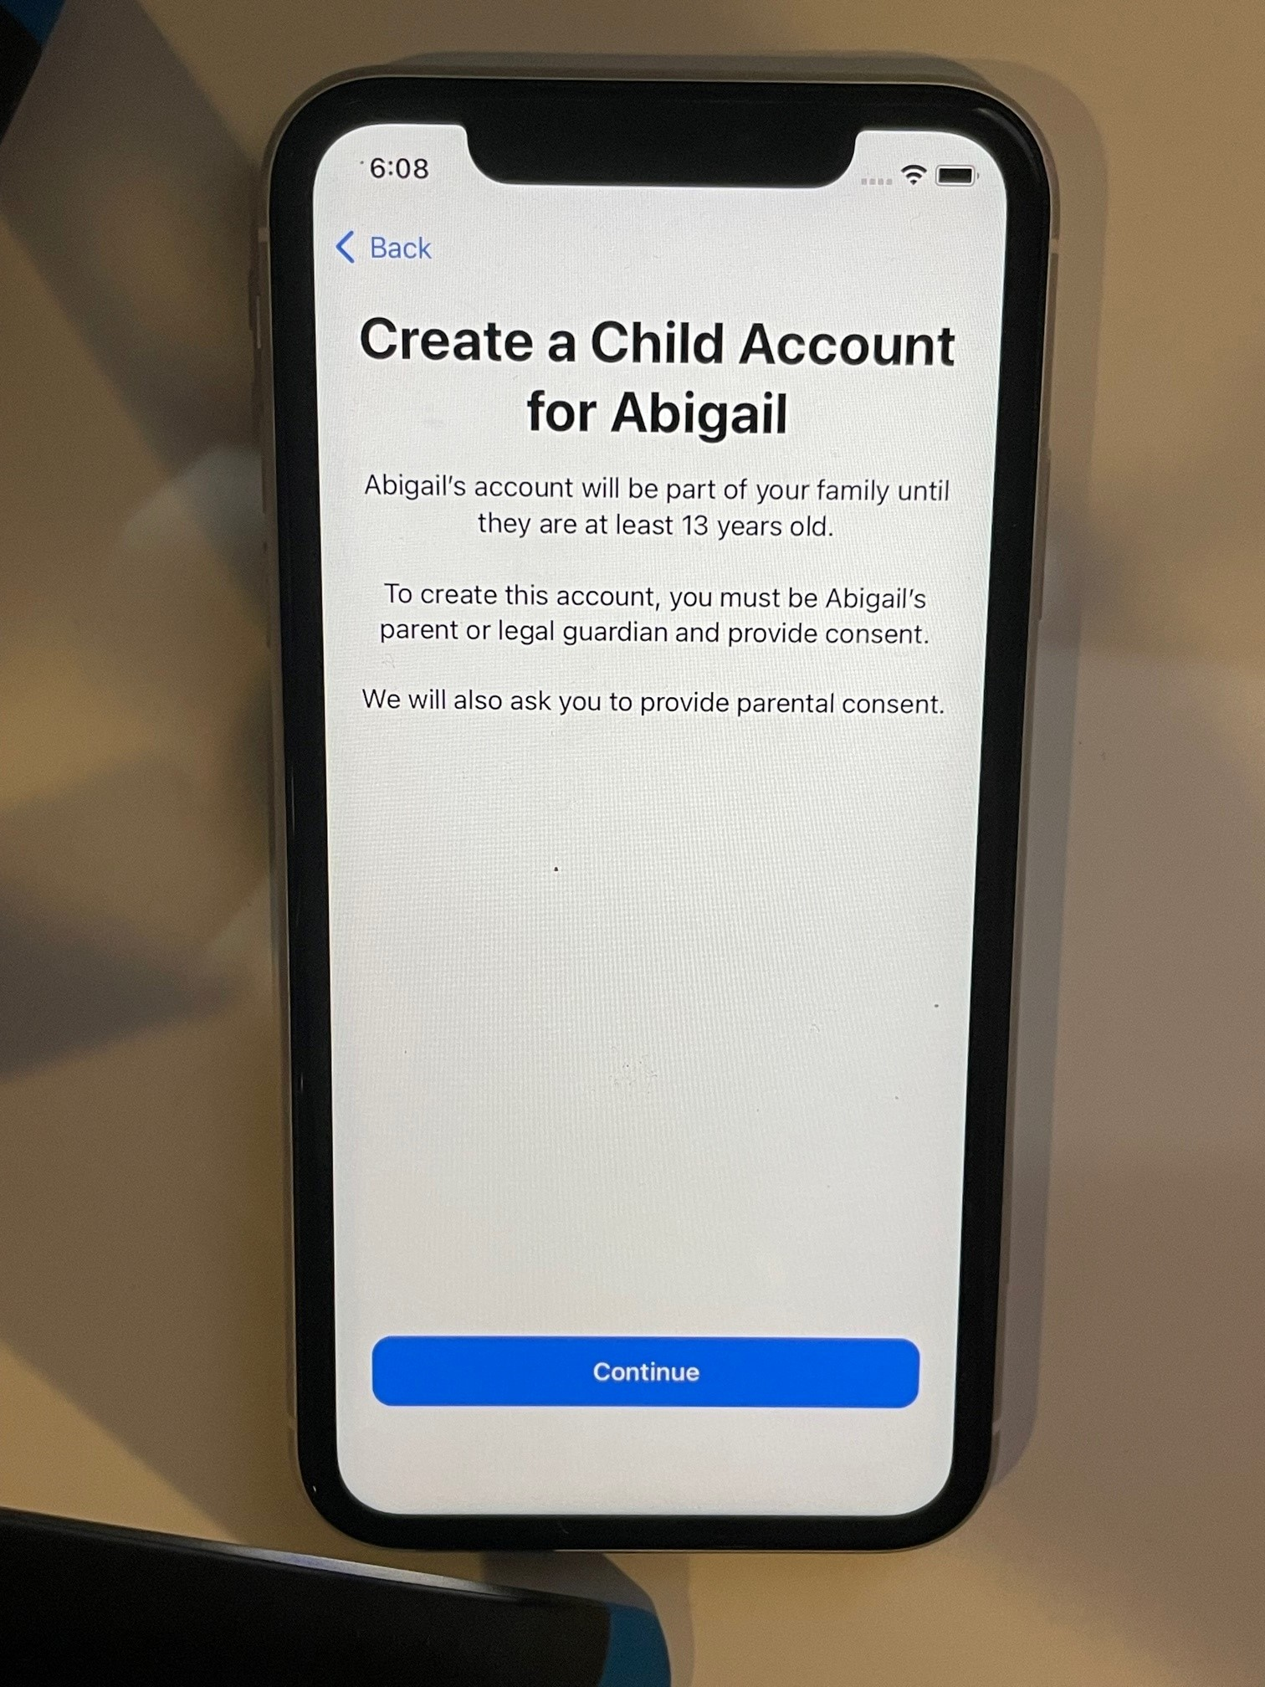
-You will be prompted to create a child account.

Slide 20
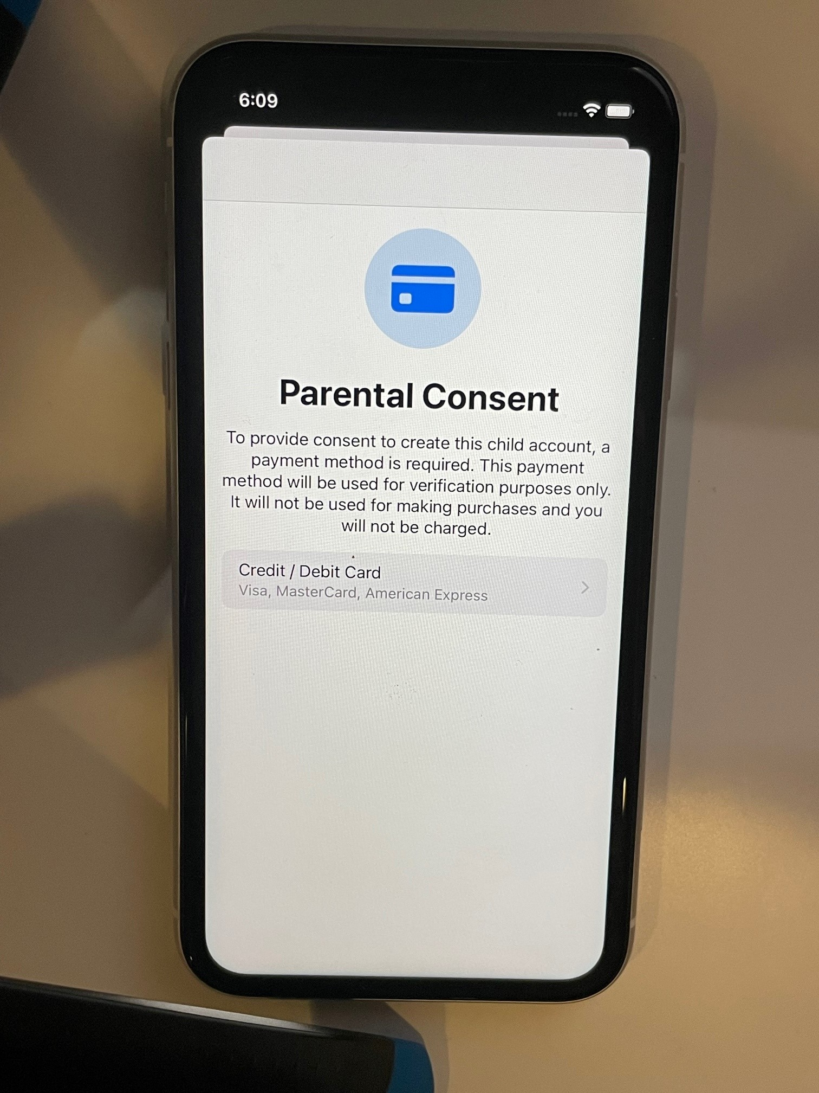
-You must input Credit/Debit card info as verification.
-You will not be charged anything.

Slide 21
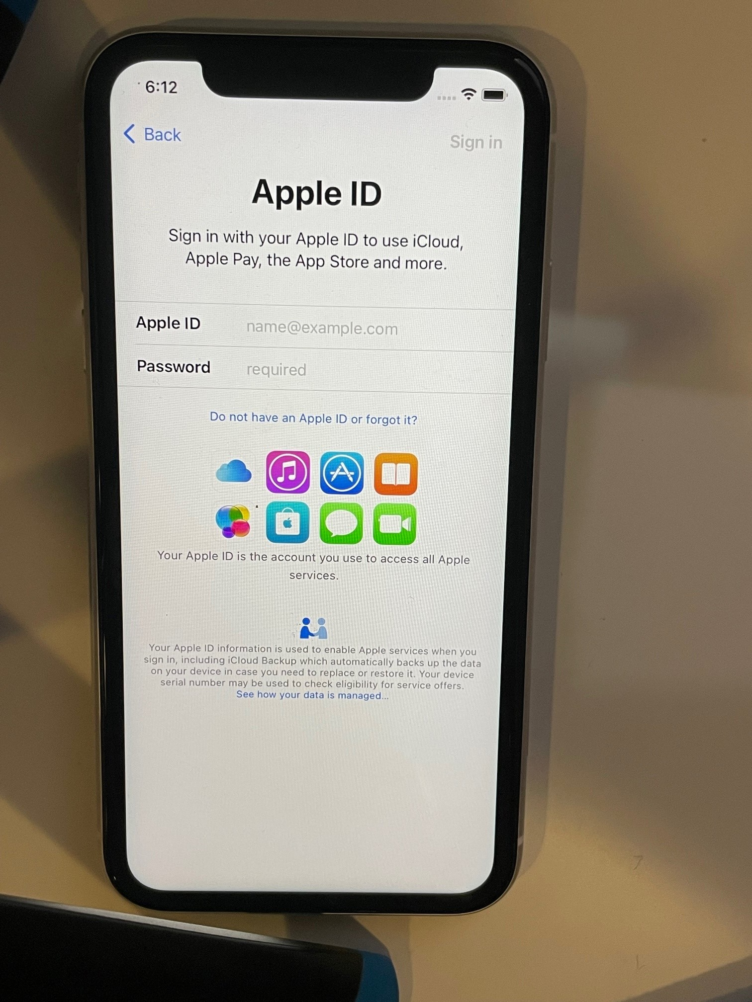
-Create an Apple ID for your child.
-I recommend they not have access to it. This is to prevent them from resetting the phone.

Slide 22
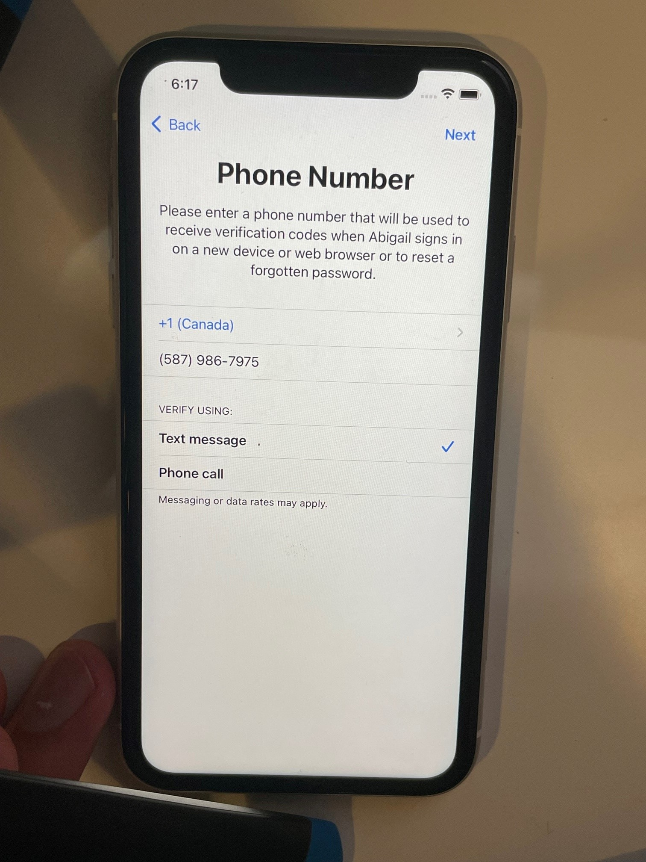
-Use your phone to verify their account.

Slide 23
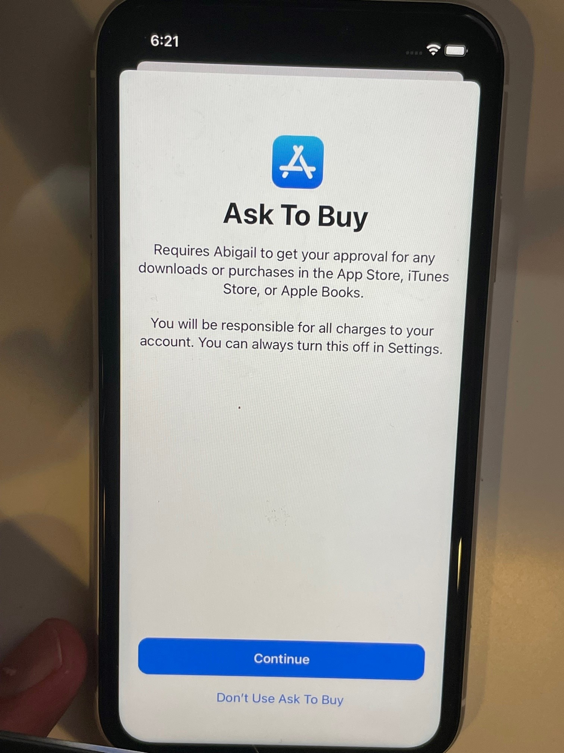
-This ensures that you approve APP Store downloads.

Slide 24
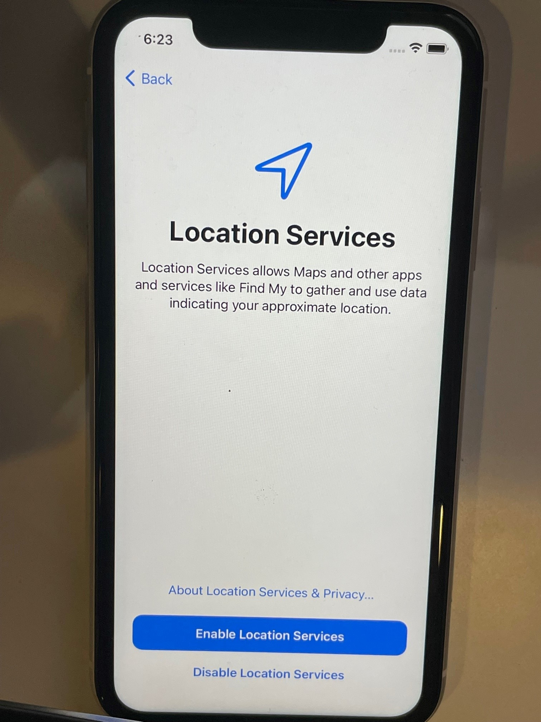
-This is helpful to see where your child is.
-This is essential to locate a lost phone.

Slide 25
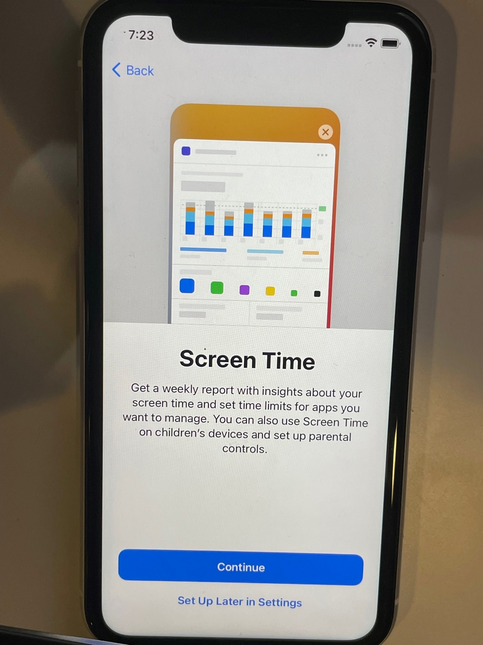
-Screen Time is the name for Apple’s Parental Controls.

Slide 26
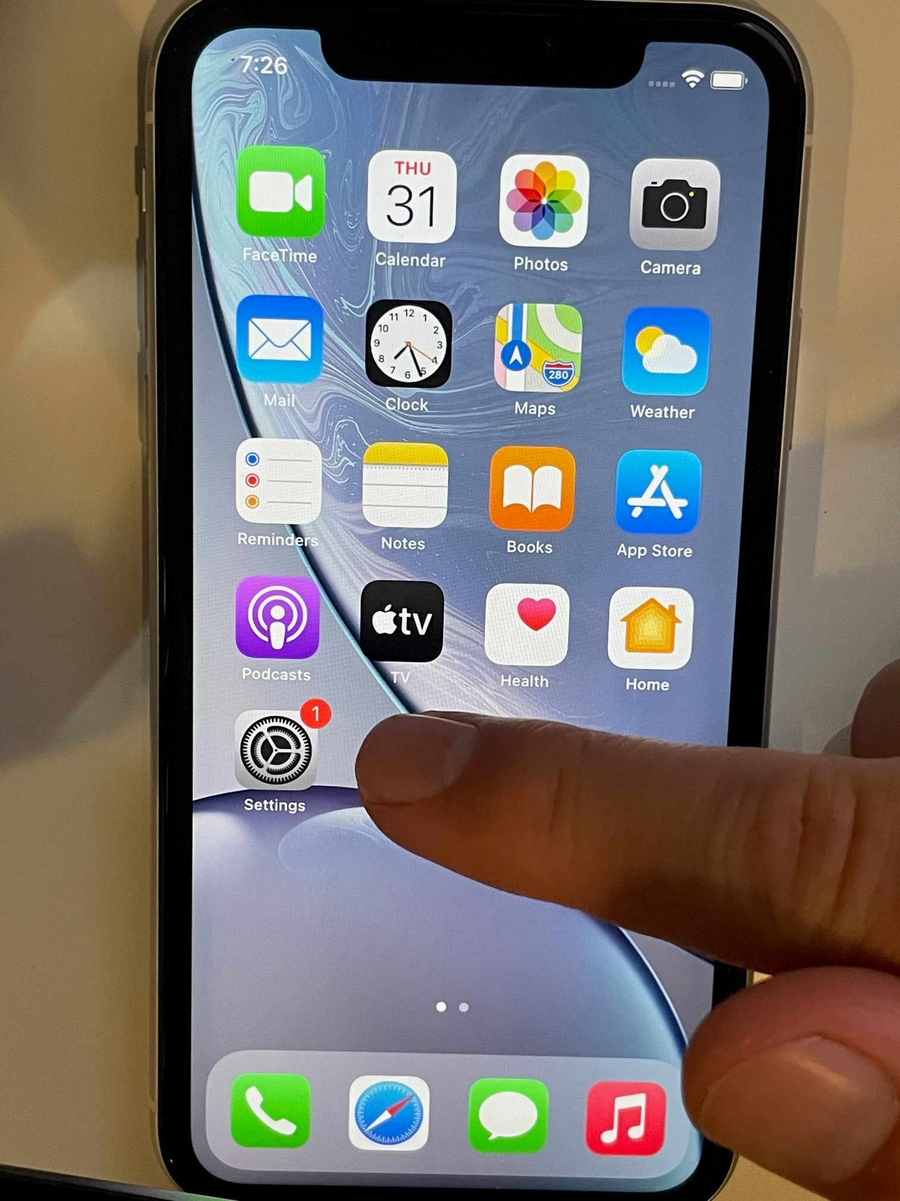
-Screen Time can be found in Settings.

Slide 27
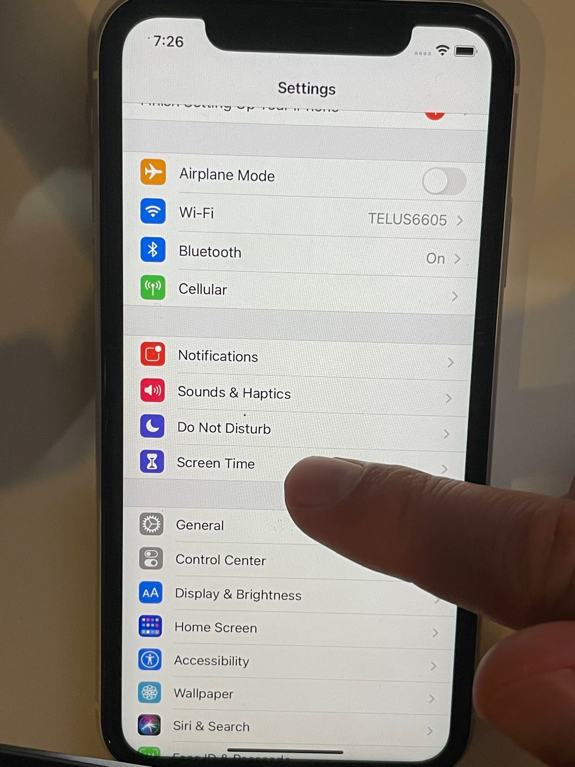
-Select Screen Time.

Slide 28
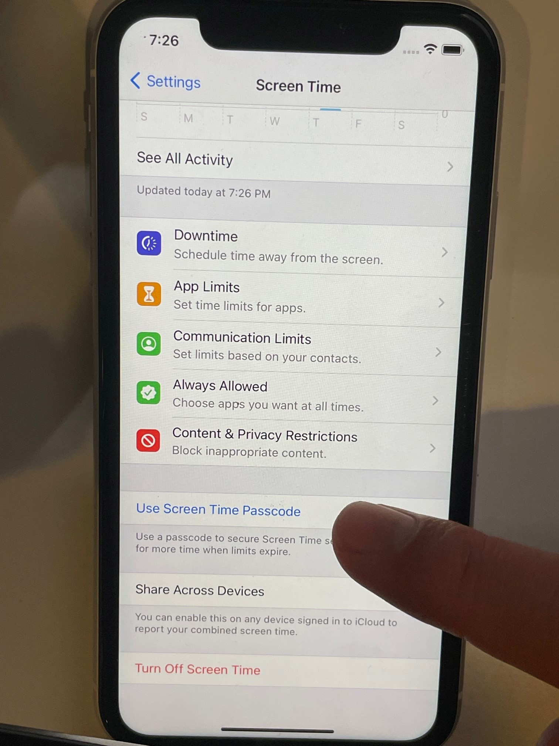
-You must set a password that your child cannot guess.

Slide 29
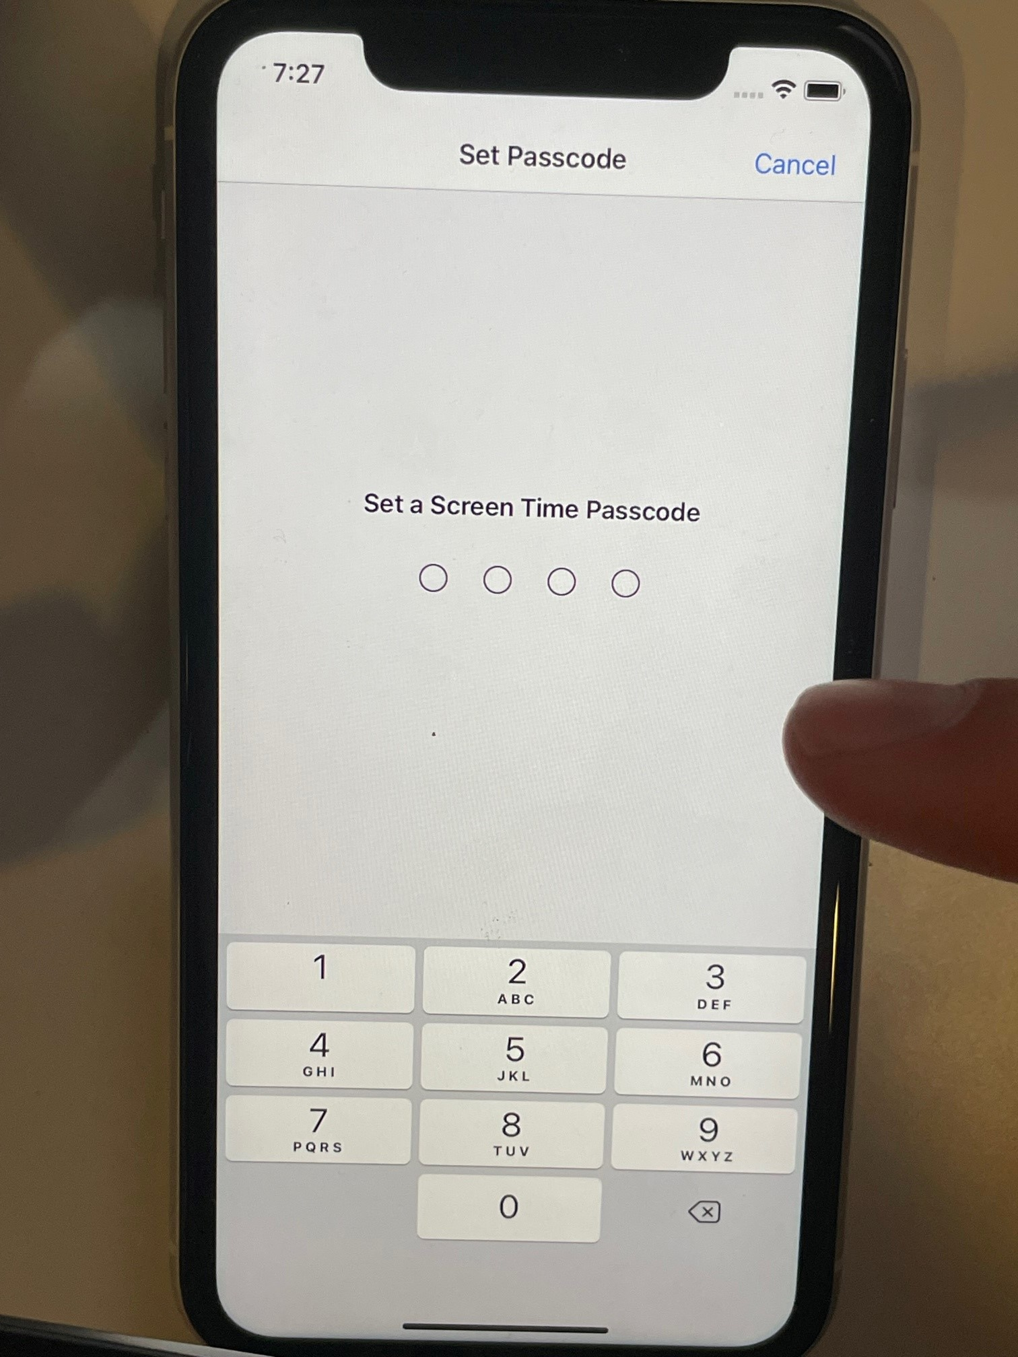
-Make sure to remember it as it will be required to make future changes.

Slide 30
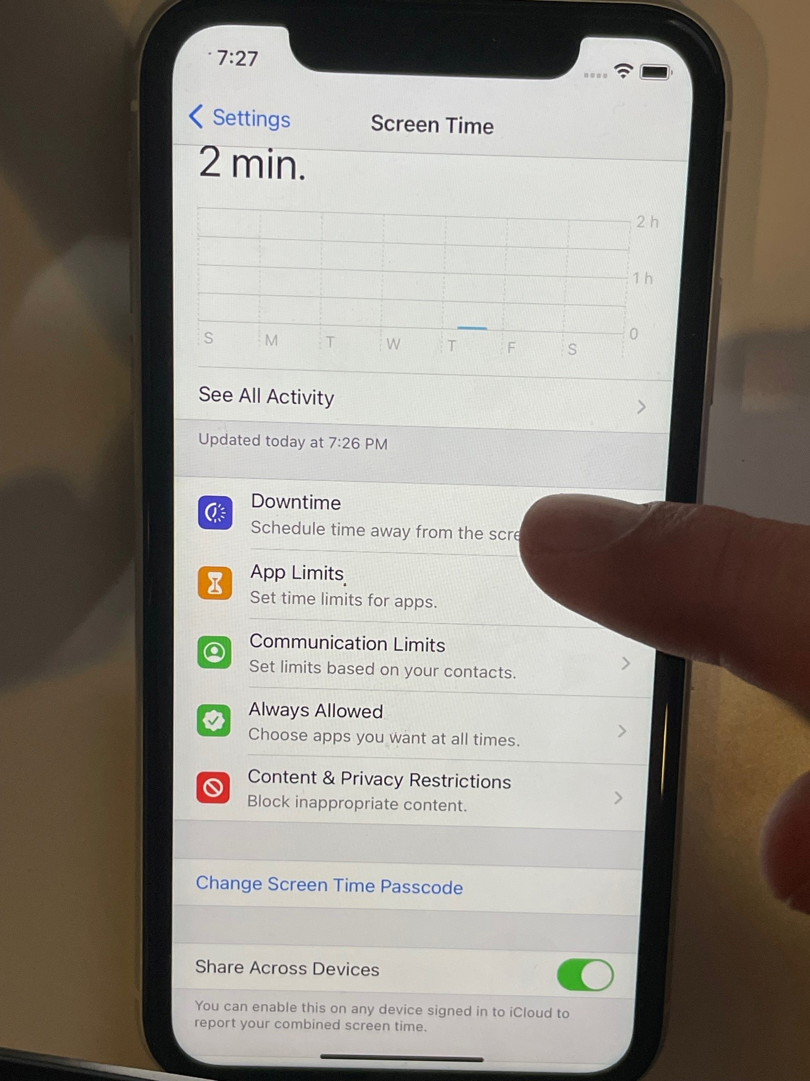
-Select Downtime.
-This is when the phone apps stop working.
-I set it from 8pm – 7am.

Slide 31
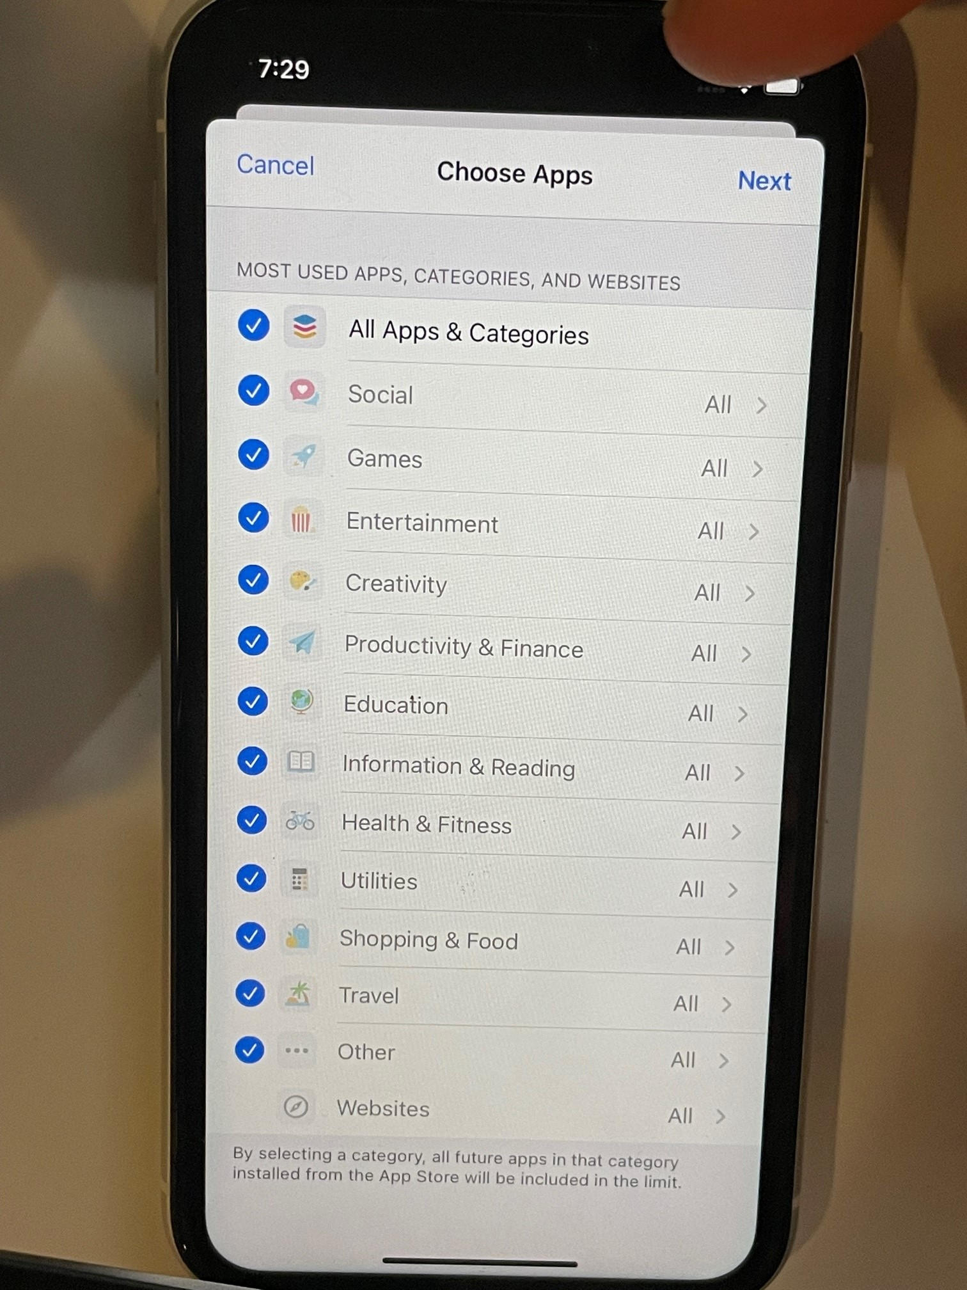
-You can specify which Apps to include.
-I used all.

Slide 32
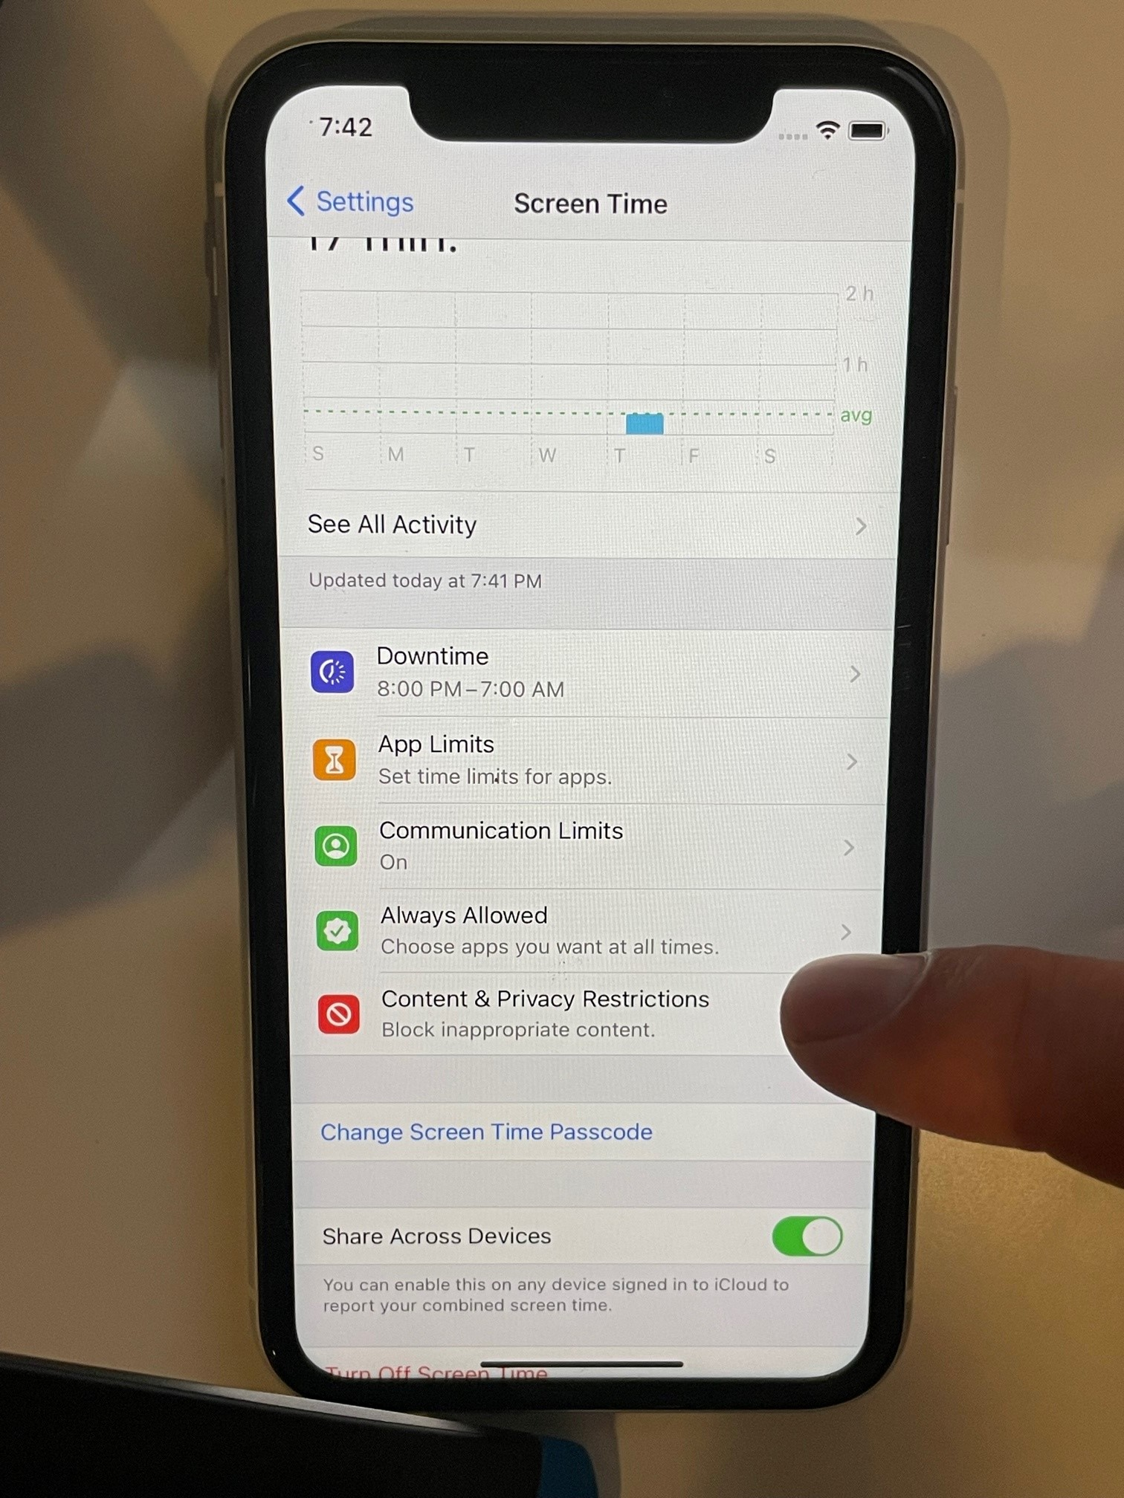
-If you allow Browser, you can block some content.
-You can also choose to only allow specific sites.

Slide 33
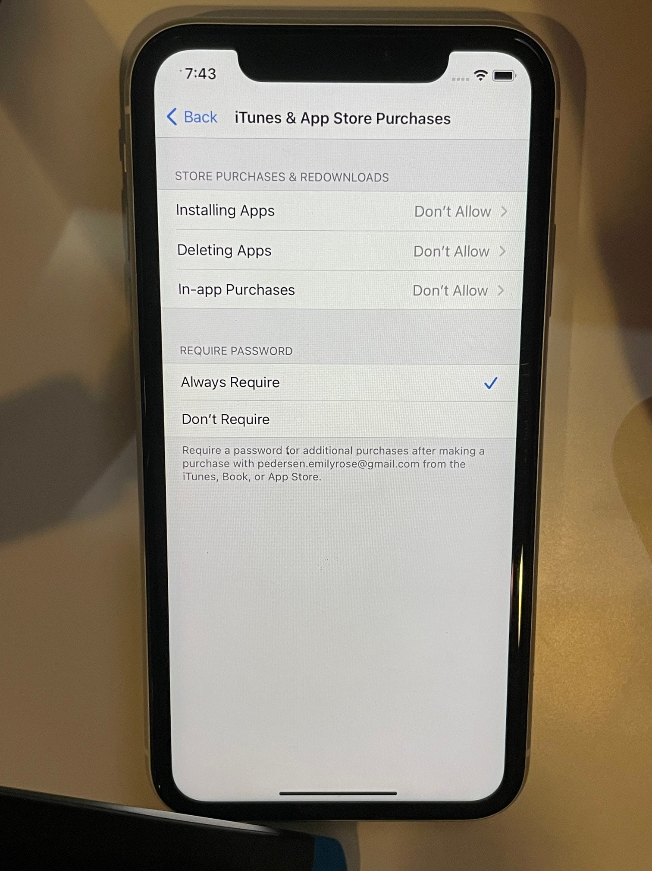
-You may allow Apps to be Installed as they must be approved by you.

Slide 34
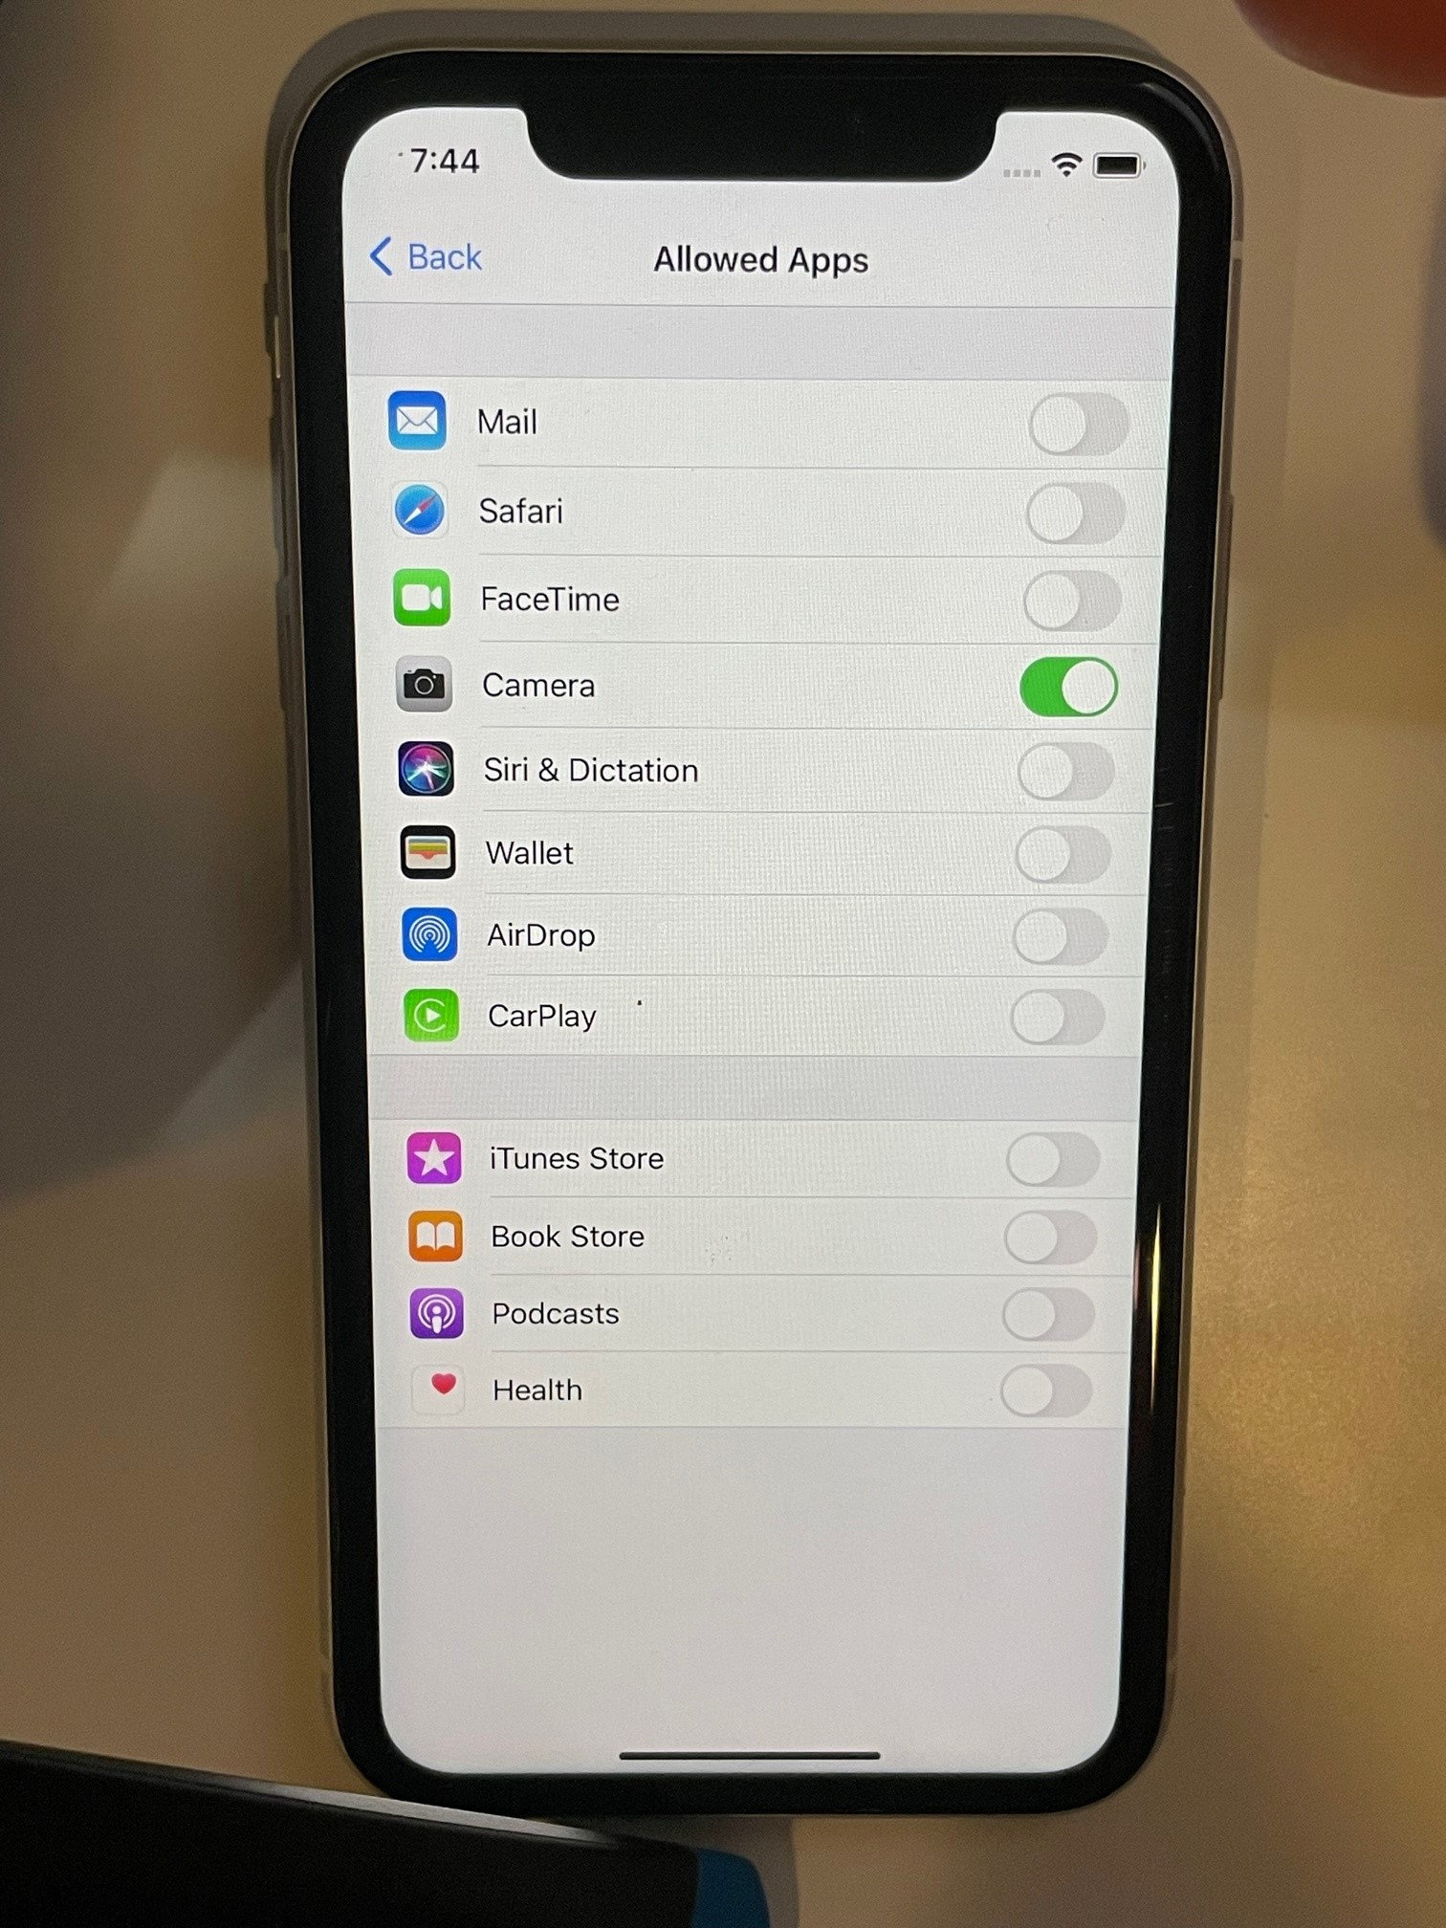
-You can choose which apps to allow.
-This can be changed by you anytime.

Slide 35
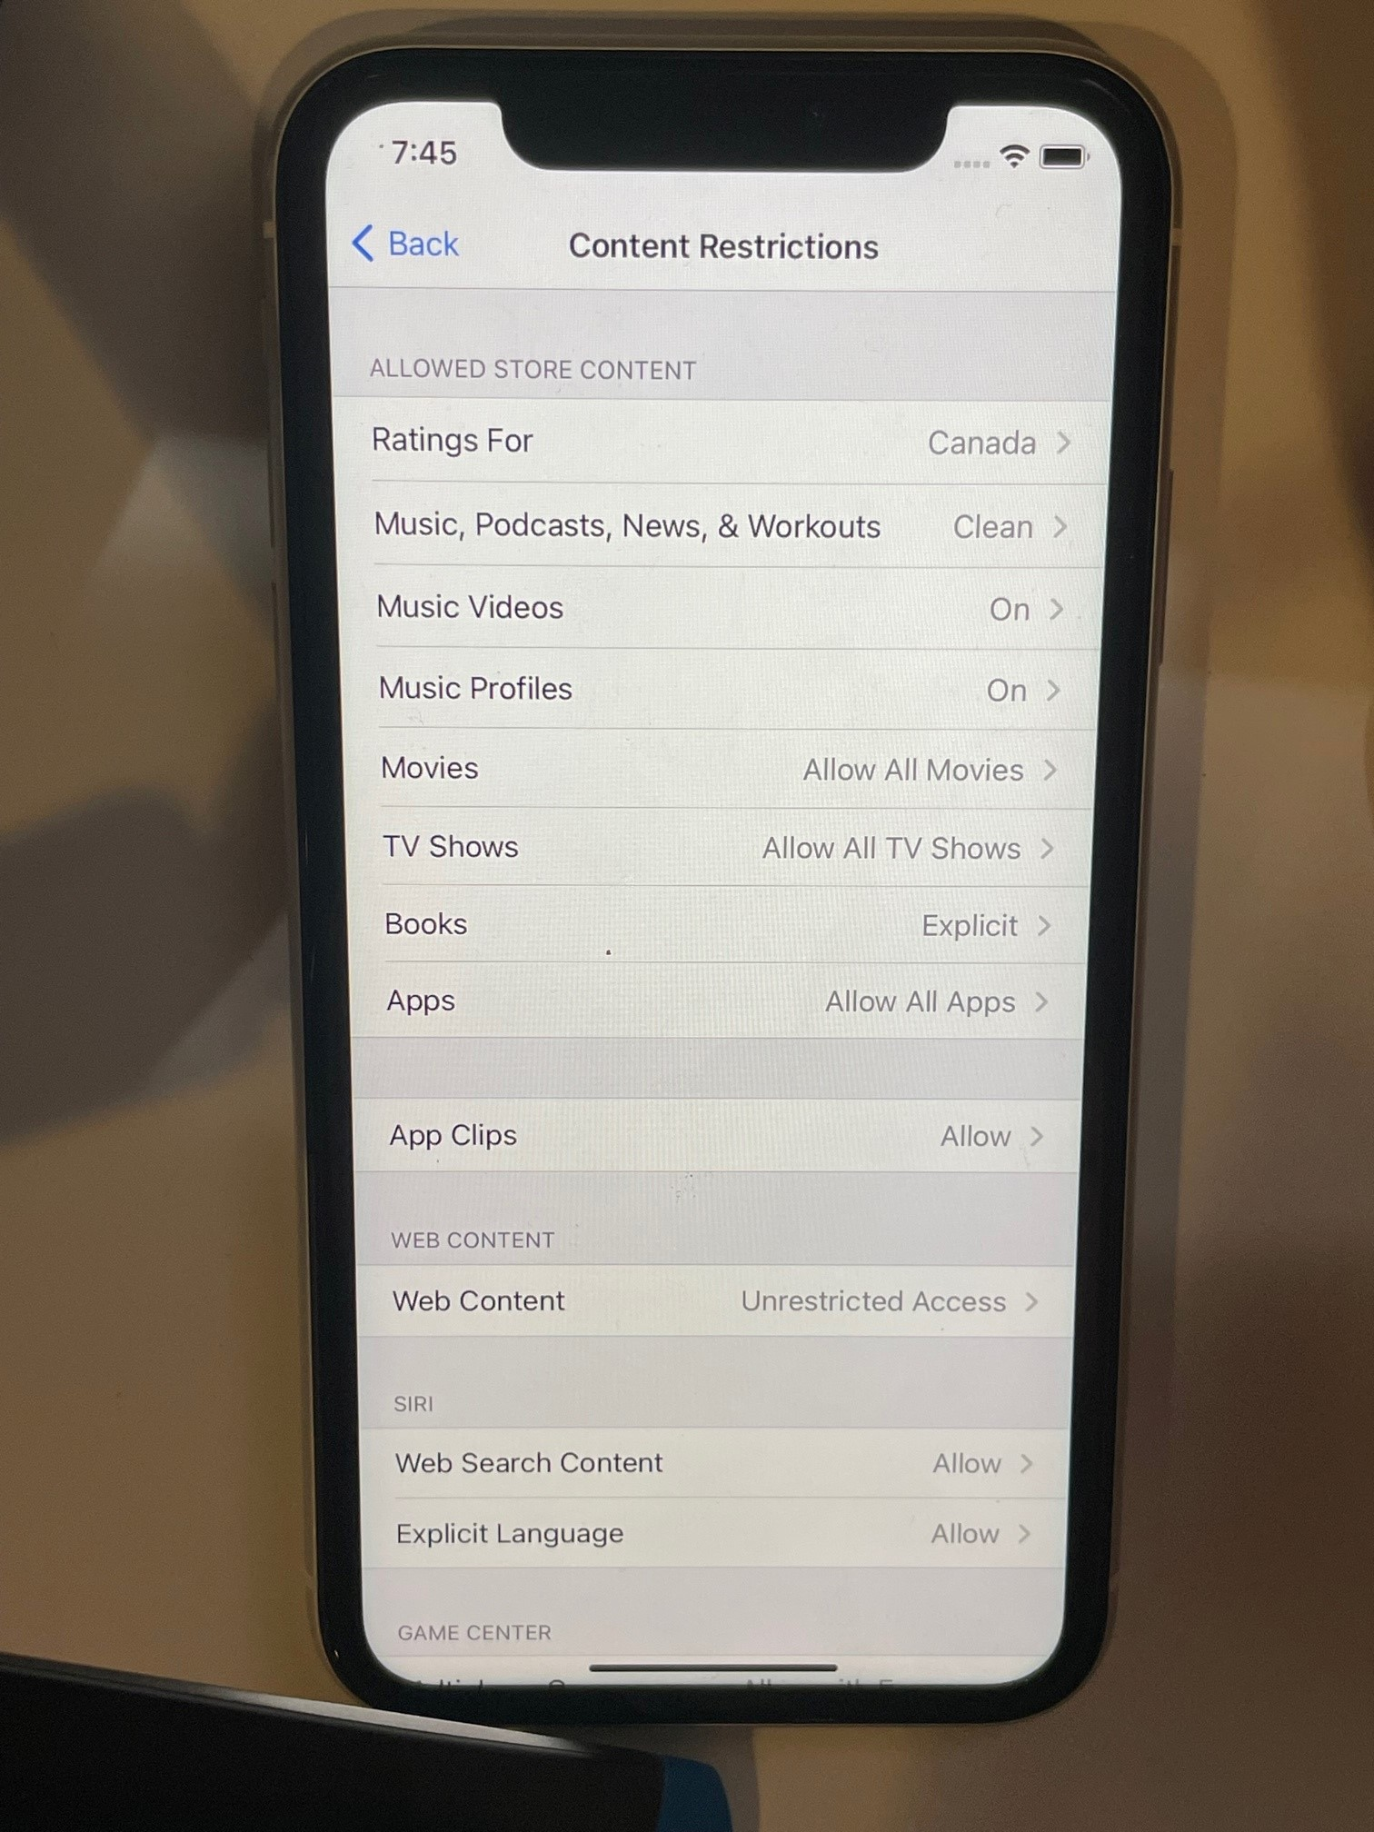
-There is a high level of customization.
-As your child matures, restrictions can be changed.
***This process will change over time.

Slide 36
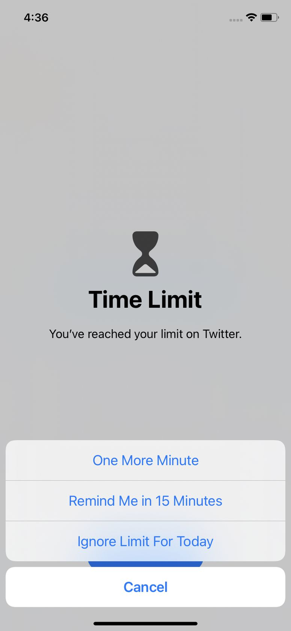
-

Slide 37


